Slide 1
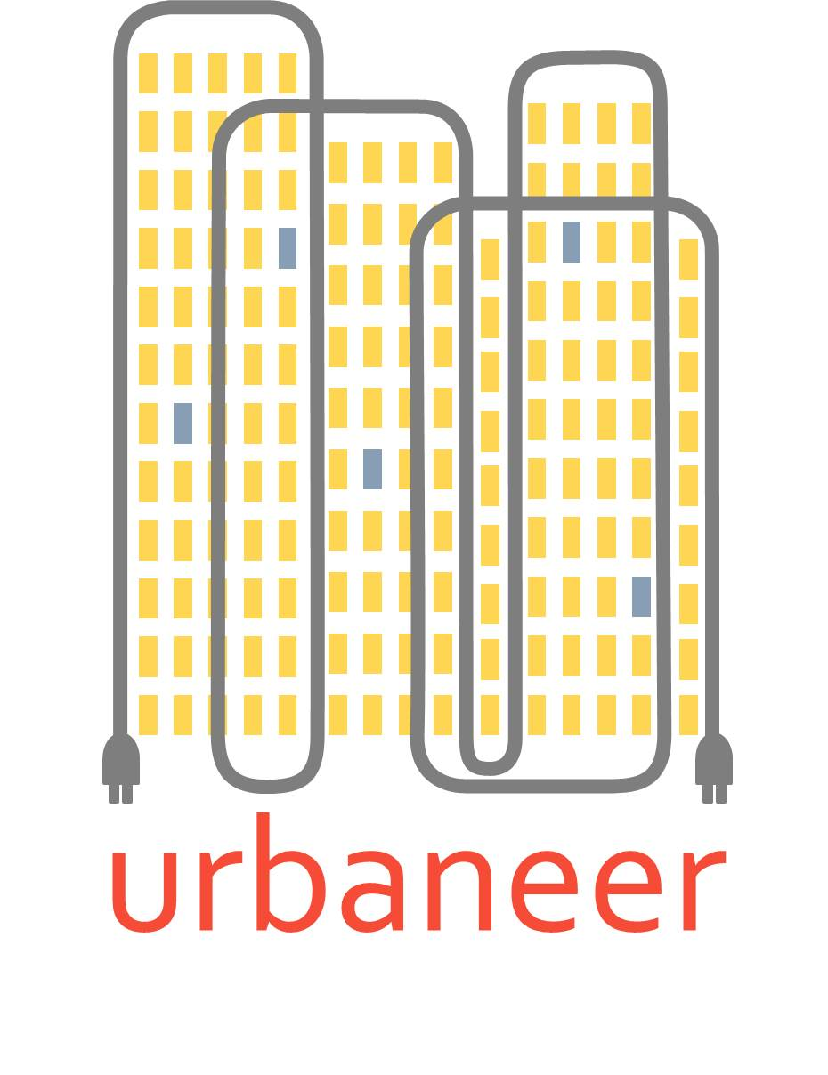
Welcome and introduction
Gearoid Lane
AgilityEco

Slide 2
So what was urbaneer?
A two-year R&D project
part-funded by DECC
under the Energy Entrepreneurs Fund.
A collaboration between AgilityEco and BRE
Aim: to develop a methodology and toolkit
to apply IoT technology to optimising retrofit
of complex residential blocks

Slide 3
It aimed to solve a problem we often encounter in client projects
Landlords usually have poor information about internal living conditions in blocks
Temperatures, humidity, dampness, stuffiness…
Many blocks are now being retrofitted to improve quality of life and save residents money
Insulation, glazing, heating, renewables…
But in absence of data, retrofit can lead to problems:
Over-design of heating based on SAP/rdSAP consumption figures => wasted money
Increased air-tightness => humidity/dampness
Increased air-tightness => poor air quality (stuffiness)
Increased insulation and better heating => summer (and even winter) over-heating
…which can mean wasted money, sub-optimal design, adverse health impacts
By collecting such data using IoT technology and applying BRE analytics to the data, we aimed to derive insights to improve retrofit

Slide 4
So how does it work?
Sensors fitted in sample of flats in a block
temperature, CO₂, humidity, motion, energy use
Data transmitted via broadband hub to cloud-based server
Data gathered for a period (ideally a whole winter heating season)
BRE analytics applied and report provided to landlord
Informs the retrofit design
Ideally data then collected for another winter season to help landlord assess the real-world impact of retrofit intervention

Slide 5
We got some interesting findings from both pre- and post-retrofit analyses
Pre-retrofit:
Evidence of poor unhealthy living conditions in some flats
Evidence of under-heating due to fuel poverty
Evidence of ineffective heating equipment in some cases
Post-retrofit:
Resident savings even after comfort-taking
Some overheating possibly linked to poor controls
No decrease in air quality
More from BRE later…..

Slide 6
We learned a lot of lessons and need to solve some issues before we have a viable proposition
Equipment reliability
Reliance on broadband
Cost of equipment and service
Need for more automation of insight generation
More from Nick and Russell later

Slide 7
But we are confident these issues can be solved and are making progress
Dramatic reductions in cost are coming through
Dramatic improvements in reliability are possible – using alternative communications technology
Smart metering will eventually help with energy data – but blocks will be last!
And urbaneer has helped us automate and speed up insight generation

Slide 8
Arup/CLT market research support and client dialogue suggest new applications for urbaneer
Duty of care: health, wellbeing & vulnerability
Safety and security
Asset management
Possible role in residential blocks as “intelligent buildings”

Slide 9
Local authorities and social housing can be at forefront of IoT in housing
Density and volume of housing – cost-effective scaled rollout
Ability to fund or access funding for S.H.
Applications can be unlocked B2B that may be more difficult in B2C
Larger blocks may be valuable energy assets:
DSR, ToU, ancillary service, microgrids

Slide 10
The future for urbaneer
Finalising project deliverables and in particular automation of insight generation
Further technology trials underway to get the right technical solution
Seeking further funding for getting to market and new application development
Seeking interested S.H. partners for trials

