Slide 1
BRE: urbaneer findings
Robbie Thompson BRE 15 July 2016

Slide 2
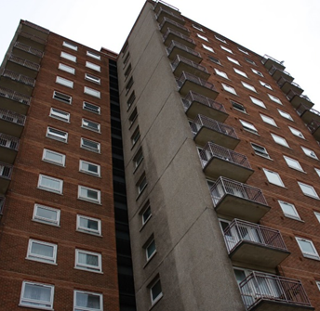
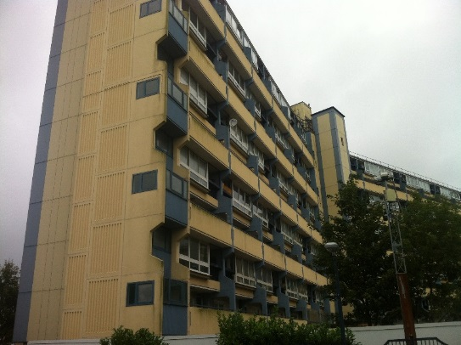
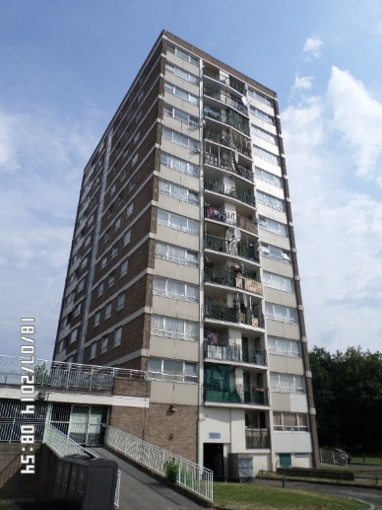
Three tower blocks
Block 2
1950-1966 concrete system build, single glazed with underfloor electric heating, no thermostatic or time control
Block 3
1967-1975 concrete system build, double glazed, electric storage heaters
Block 1
1967-1975 build, uninsulated cavity wall, double glazed with electric storage heaters.

Slide 3
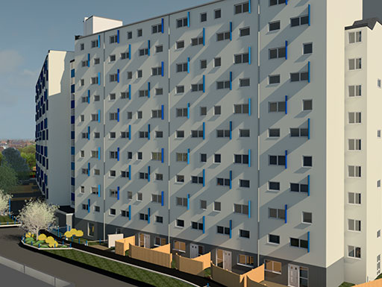
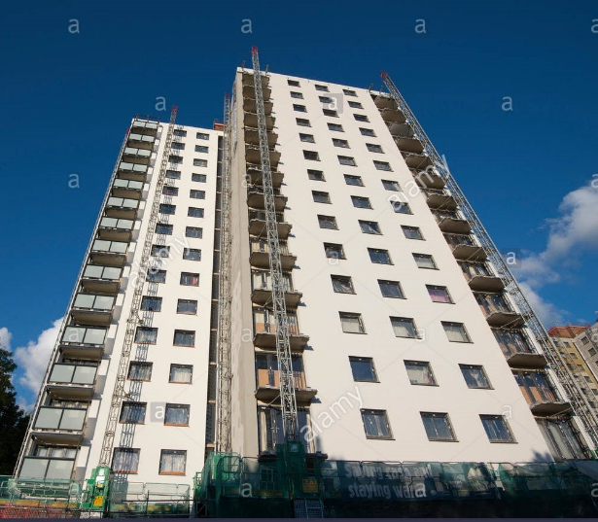
Three tower blocks
Block 2
External wall insulation Double glazing District heating
Block 3
Enerphit (passivhaus) retrofit External Wall Insulation MVHR Double Glazing Enclosed Walkways Not Complete
Block 1
External wall insulation Double glazing District heating

Slide 4
Property overview
Data collection
1* Electricity
3* T&RH
3* PIR Occupancy
1* CO₂
Occupancy assessment
EPC, Green Deal
Building | Properties
Enfield | 10
Portsmouth | 10
Nottingham | 13

Slide 5
First Winter data analysis – Internal Temperature
Block 1 and 3
External temp coupling
Low winter temps (below CIBSE Comfort)
High summer temp
No property meets RdSAP assumptions
Block 2
Constant high temperatures

Slide 6
Heat Maps
Block 3
Ineffective storage heaters
Block 1
Consistently low temperatures
Block 2
All day high temperatures

Slide 7
First Winter data analysis
 | Heat Loss Parameter W/m²K | Heat Loss Parameter W/m²K RdSAP | Data Quality Score
P1 | 2.23 | 2.32 | 60%
P2 | 2.15 | 2.32 | 81%
P3 | 1.53 | 1.55 | 46%
P4 | 1.50 | 1.55 | 61%
P5 | 2.58 | 3.00 | 75%
Mean | 2.00 |  | RdSAP: 2.15
Standard Deviation | 0.47
 | Heat Loss Parameter W/m²K | Data Quality Score
N1 | 1.58 | 40%
Mean | 1.58 | RdSAP: 2.92
Standard Deviation | N/A

Slide 8
First Winter data analysis - Electricity use
Below predicted energy use, likely to lead to poor returns from insulation

Slide 9
First Winter data analysis - Occupancy
High occupancy – doesn’t equate to high energy use

Slide 10
Second Winter data Analysis Internal Temperatures - Block 1
Consistently higher internal temperatures within CIBSE Comfort Criteria
Better Occupancy feedback
Minimal overheating

Slide 11
Second Winter data Analysis Internal Temperatures - Block 2
Similar temperatures
Better occupancy feedback
Minimal overheating

Slide 12
CO₂ Levels – Block 1
Pre Retrofit CO2
Ref | 14 | 13 | 12 | 11 | 10 | 6 | 5 | 3 | 2 | Average
Max Value (ppm) | 1,830 | 3,050 | 1,480 | 1,730 | 3,430 | 3,750 | 2,730 | 2,000 | 2,920 | 2,640
> 1,000ppm | 12.3% | 47.9% | 1.5% | 29.0% | 49.0% | 32.9% | 41.1% | 20.1% | 46.6% | 33.5%
> 1,500ppm | 2.0% | 17.7% | 0.0% | 1.5% | 21.9% | 11.4% | 14.1% | 1.5% | 19.9% | 11.0%
> 2,000ppm | 0.0% | 3.3% | 0.0% | 0.0% | 7.9% | 3.5% | 3.5% | 0.0% | 5.0% | 2.9%
Post Retrofit CO2
Ref | 13 | 11 | 10 | 6 | 3 | 2 | Average
Max Value (ppm) | 2540 | 2460 | 2510 | 2540 | 1150 | 2540 | 2,290
> 1,000ppm | 46.6% | 8.5% | 7.2% | 9.8% | 2.4% | 31.5% | 17.7%
> 1,500ppm | 6.4% | 0.6% | 0.4% | 1.3% | 0.0% | 5.2% | 2.3%
> 2,000ppm | 0.4% | 0.0% | 0.2% | 0.2% | 0.0% | 0.3% | 0.2%
Post retrofit shows better maximum CO₂ levels
Poor CO₂ can impact concentration, headaches and drowsiness
May indicate regular window opening – lower energy savings

Slide 13
CO₂ Levels – Block 2
Pre Retrofit CO2
Ref | 10 | 5 | 3 | Average
Maximum CO₂ ppm | 1,430 | 1,130 | 6,970 | 3,180
> 1,000ppm | 1.6% | 0.13% | 51.1% | 17.6%
> 1,500ppm | 0.0% | 0.0% | 22.0% | 7.3%
> 2,000ppm | 0.0% | 0.0% | 10.9% | 3.6%
Post Retrofit CO2
Ref | 10 | 9 | 7 | 5 | 4 | 2 | Average
Maximum CO₂ ppm | 1,640 | 6,430 | 1,290 | 1,210 | 1,760 | 2,210 | 2,420
> 1,000ppm | 3.4% | 70.7% | 0.6% | 0.3% | 8.7% | 7.4% | 15.2%
> 1,500ppm | 0.1% | 40.7% | 0.0% | 0.0% | 0.68% | 0.2% | 6.9%
> 2,000ppm | 0.0% | 26.8% | 0.0% | 0.0% | 0.0% | 0.2% | 4.5%
Post retrofit shows similar CO₂ levels and high
Two properties had CO₂ levels close to HSE’s workplace exposure limit of >5,000 for more than 8 hours
CO₂ levels highest 5am suggesting living used as bedroom

Slide 14
Humidity - Block 1
CIBSE Guide A recommends that relative-humidity should be in the range of 40-70%.
Percentage of hours where average hourly humidity exceeded 70%
 | N12 | N11 | N10 | N9 | N8 | N7 | N5 | N4 | N3 | N2 | N1 | Average
Before Retrofit | 1.0% | 7.8% | 4.1% | 0.2% | 7.3% | 13.5% | 6.8% | 8.0% | 82.9% | 23.0% | 15.4% | 15.5%
After Retrofit | NA | 8.7% | NA | 0.2% | 0.0% | 0.1% | NA | 0.0% | 0.6% | 0.0% | 0.2% | 1.2%
Percentage of hours where average hourly humidity below 40%
 | N12 | N11 | N10 | N9 | N8 | N7 | N5 | N4 | N3 | N2 | N1 | Average
Before Retrofit | 9.7% | 10.5% | 0.7% | 2.1% | 0.0% | 0.2% | 5.2% | 0.0% | 0.0% | 0.0% | 0.0% | 2.6%
After Retrofit | NA | 3.3% | NA | 15.6% | 5.5% | 5.5% | NA | 6.6% | 0.0% | 21.7% | 26.7% | 10.6%
High humidity within the property has dropped significantly.
Humidity drop is likely to lead to a significant improvement in condensation risk, mould growth and high humidity associated health issues.
Low humidity has increased.

Slide 15
Humidity - Block 2
CIBSE Guide A recommends that relative-humidity should be in the range of 40-70%.
Percentage of hours where average hourly humidity exceeded 70%
 | E9 | E8 | E7 | E6 | E5 | E4 | E3 | E2 | Average
Before Retrofit | 19.5% | 0.0% | 0.0% | 1.5% | 0.0% | 0.0% | 0.0% | 3.5% | 3.0%
After Retrofit | 2.0% | NA | 0.0% | 0.5% | 0.0% | 0.0% | NA | NA | 0.5%
Percentage of hours where average hourly humidity below 40%
 | E9 | E8 | E7 | E6 | E5 | E4 | E3 | E2 | Average
Before Retrofit | 8.0% | 81.9% | 85.6% | 30.3% | 53.9% | 36.0% | 32.1% | 3.3% | 41.4%
After Retrofit | 48.3% | NA | 88.8% | 5.8% | 33.8% | 44.1% | NA | NA | 44.2%
Humidity within the property is almost unchanged but often below 40%

Slide 16
Mould risk
Mould risk dramatically reduced
Only mould in flat above unheated space
Mould risk reduced
Only mould in flat above unheated space (with high internal temperatures)

Slide 17
Energy use – Block 2
 | Floors | Pre RdSAP cost per flat (mid) | Post RdSAP cost per flat (mid) | Cost per flat (Pre) | Cost per flat (Post) | Saving per flat | Percentage saving
Meter 1 | G,1,2,3 | £884 | £423 | £1,150 | £1,070 | £80 | 7.0%
Meter 2 | 4,5,6 | £884 | £423 | £1,200 | £700 | £530 | 43.0%
Meter 3 | 7,8,9 | £884 | £423 | £1,400 | £1,040 | £380 | 26.4%
Meter 4 | 10,11,12 | £884 | £423 | £1,000 | £920 | £120 | 11.7%
Average |  | £884 | £423 | £1,260 | £970 | £280 | 21.8%
Total building |  | £44,500 | £21,150 | £60,300 | £46,500 | £13,800 | 21.8%
Energy saving 22%
Pre retrofit - 34% worse than RdSAP
Post retrofit – 134% worse than RdSAP
Partly due to high internal temperatures
Likely to be due to open windows.

Slide 18
Retrofit summary
Block 1:
More comfortable,
Better air quality
Low mould risk
Block 2:
Minimal to internal temperature, energy bills or air quality change
Savings not materialised due to poor heating system

