Slide 1
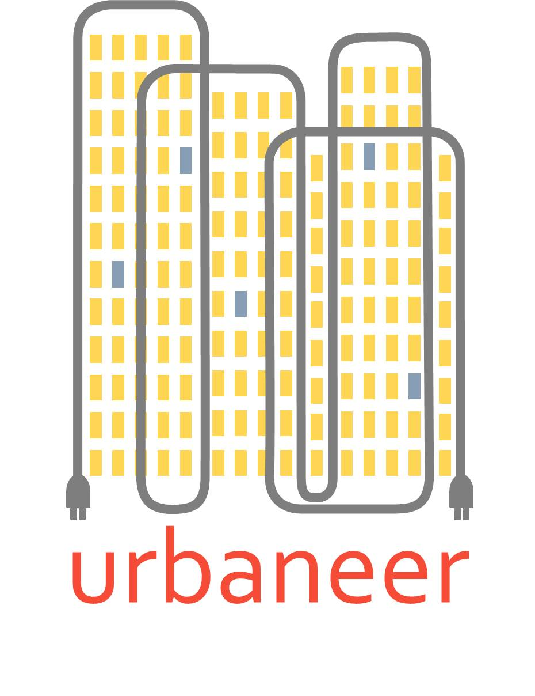
Practicalities and challenges of monitoring and measuring – lessons learned for pre-retrofit analysis
Nick Ainger
AgilitySurvey

Slide 2
Monitoring overview
Energy use and internal/external environments were monitored
Three different systems were trialled
Systems 1 & 2: used customers’ Wi-Fi and were powered by a mains plug
System 3: is GPRS enabled and hardwired into the mains
All systems required access to the residents’ homes and included:
A CT clamp to monitor electricity consumption
A sensor for temperature, humidity and CO₂
A hub to collect and transmit the data
An external environment sensor
The installation process and equipment used is critical to ensure the quality of data collected

Slide 3
Issues
Problems were caused both by limitations of the equipment used and with residents’ interaction with the kit and the project team
Technical issues were often compounded by lack of resident buy-in
Resident problems included:
Internet disconnection
Unplugging the kit
Being unable to gain access to repair issues (plugging back in, changing batteries, reconnecting to Wi-Fi)

Slide 4
Lesson learned – tenant engagement
Residents need to be fully engaged with the project
If incentives are used these should be conditional on maintaining the equipment and allowing access when needed
There should be some guidance provided with basic maintenance instructions
A sticker with contact details on the equipment itself is a good way to ensure residents know who to contact

Slide 5
Lesson learned – kit
Having a reliable system can mitigate the need for resident involvement which increases reliability
The third system we used is more robust and has resulted in fewer issues
The most common issues with the first system were:
Residents broadband being disconnected
Residents unplugging the equipment
By having a system with GPRS connectivity which is hardwired into the mains these issues are prevented
This was a more involved install process (an electrician was required) but has resulted in less time being spent rectifying problems and therefore proved to be more cost effective

Slide 6
Conclusion
Tenants eager to participate coupled with the latest self-managing equipment results in sufficient and meaningful data collection

